Slide 1
PICCSA
Team Members
Jingyi Li
Aaradhy Sharma
Sandeep Wishwala
Khajan Joshi
Summer 2020
Project Team 7
1

Slide 2
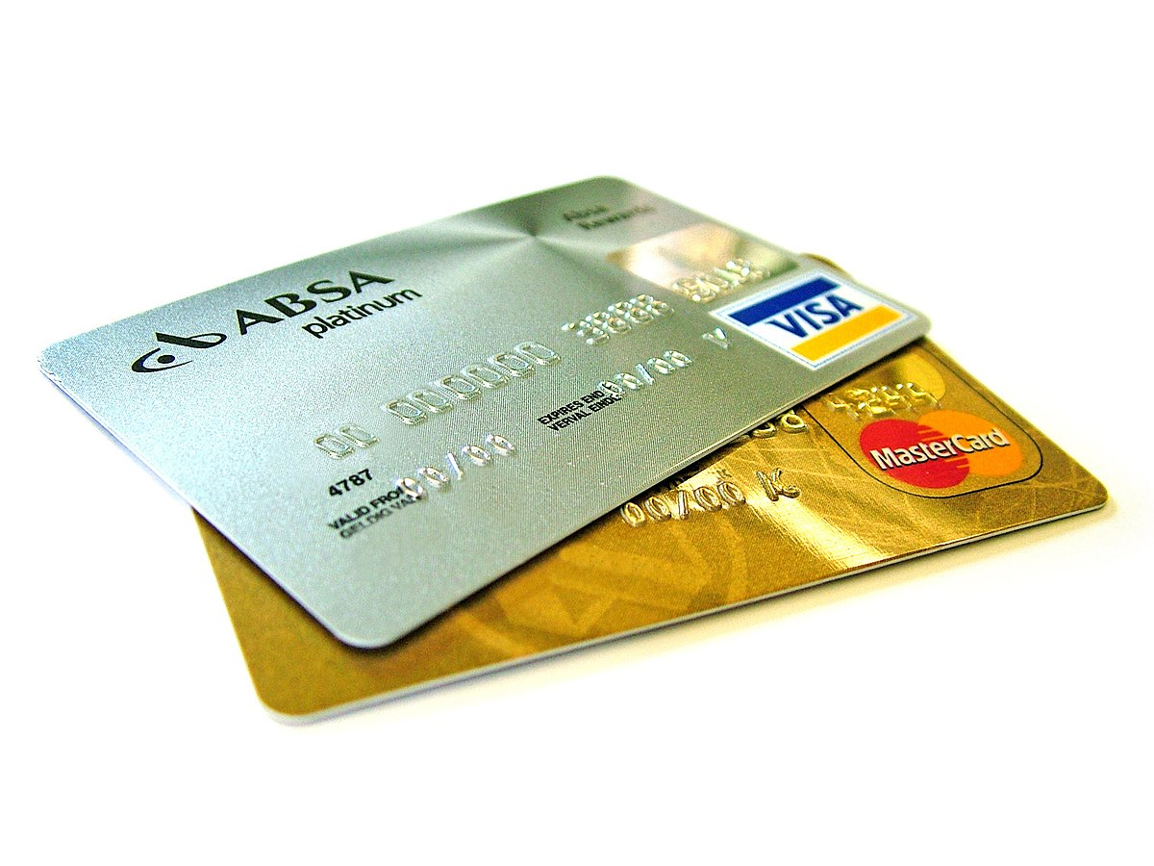
Vision
An E-Wallet App
With 2FA Enforcement
Available for different devices
solution
Summer 2020
Project Team 7
2

Slide 3

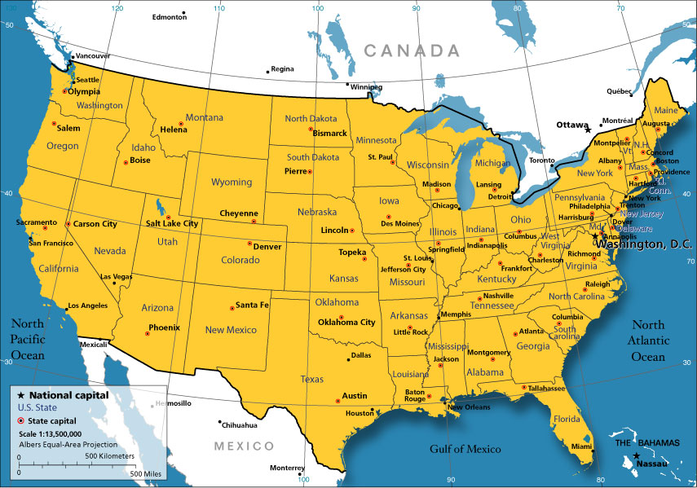

Unmet Needs
Platform Independence
US Availability
Use of push notification feature
Summer 2020
Project Team 7
3

Slide 4

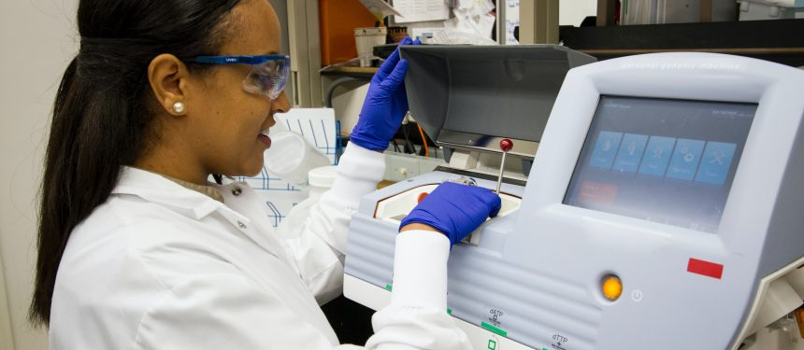

Customer Segments
International Student
OPT & H1B Holder
Average American Citizen​​
Summer 2020
Project Team 7
4

Slide 5



Use Cases
International Student
Security features
Limit on amount Of transaction
​
Benefits such as discount on university books and university canteen
Limit No. of transactions
Summer 2020
Project Team 7
5

Slide 6
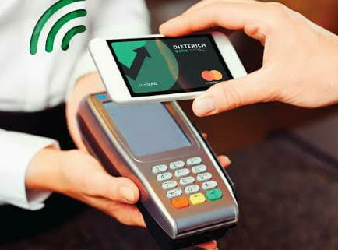

Use Cases
Merchant
Fast Payment
Loyalty Bonus
Summer 2020
Project Team 7
6

Slide 7
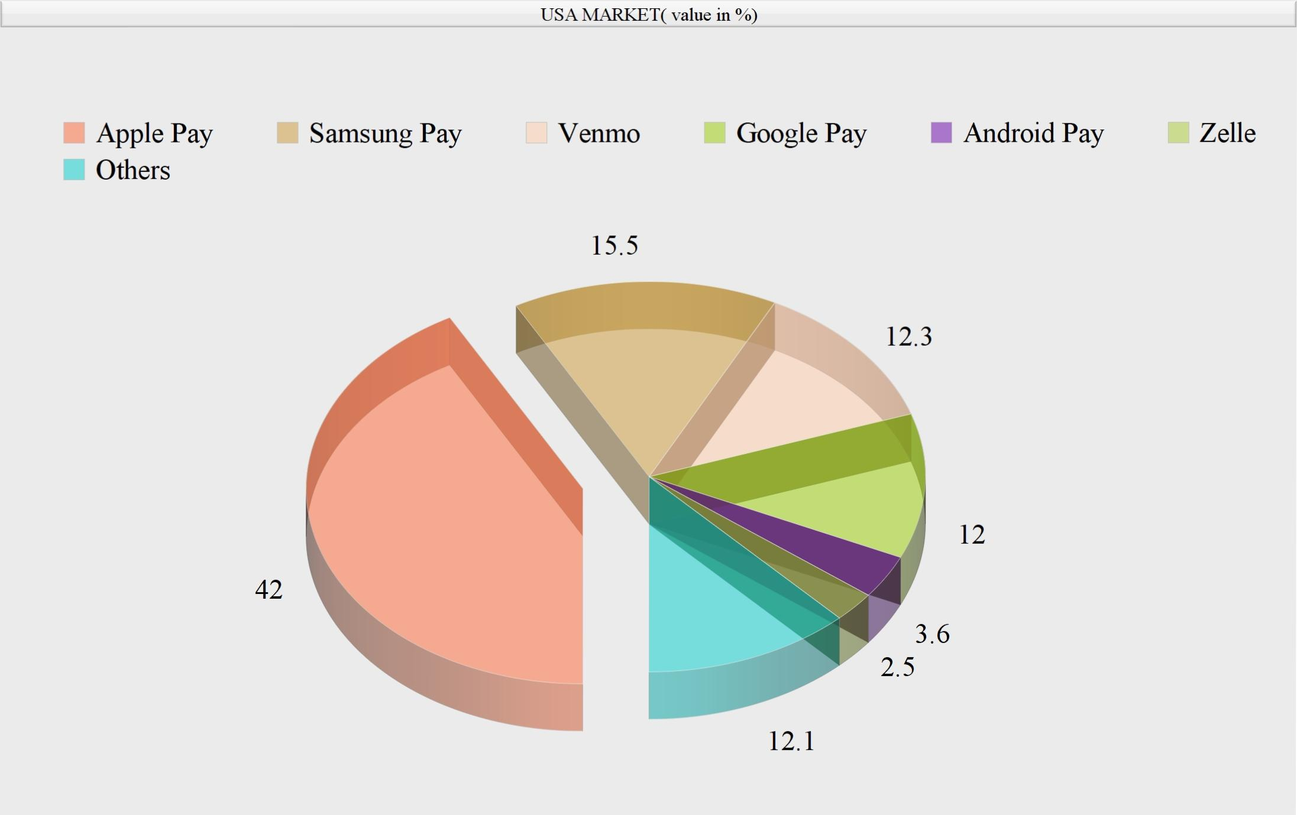
Competitive Analysis
Only for iOS devices
Apple Pay
Samsung Pay
Only for Samsung devices
Only for Peer-to-Peer payments
Venmo
Summer 2020
Project Team 7
7

Slide 8
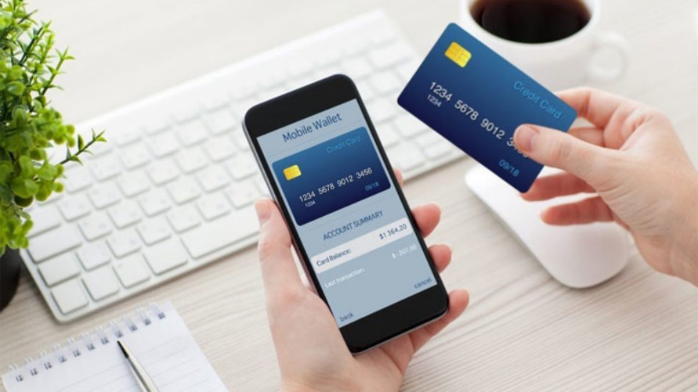
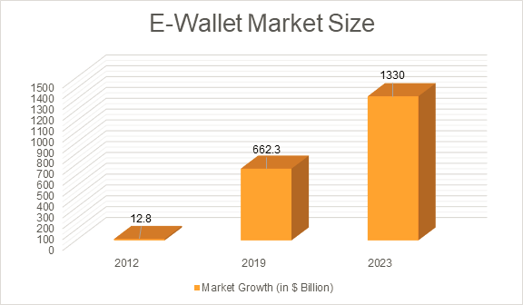
Market Size
2012 - $12.8 billion
2019 - $662.3 billion
2023 - $1.33 trillion (estimated)
Jaime Toplin (2020). US MOBILE WALLETS IN 2020 AND BEYOND. Retrieved from https://www.businessinsider.com/us-mobile-wallets-report
Summer 2020
Project Team 7
8

Slide 9





Risks/Dependencies and Mitigations
Third Party Risk
Regulatory Risk
Strategic Risk
IT Risk
Summer 2020
Project Team 7
9

